Slide 1
Microsoft ASP.net MVC
Database-First Example

Slide 2
Database-First MVC
Create the Model from the Database like shown previously
Right-click on the Models folder
Choose Add -> New Item → ADO.net Entity Data Model
Follow the wizard (as shown in previous slides)
Add Controllers and Views
As shown previously (see slides starting with “MVC Example – Creating A Controller and Views from a Model”)
In the Data Context Class, choose the model created in previous step

Slide 3
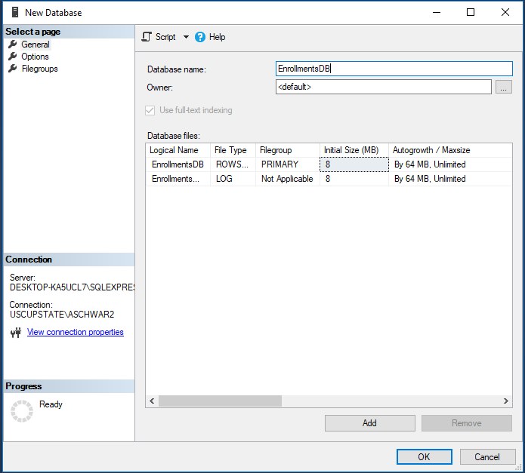
SSMS – Creating a Database
Right-click on the Database folder and choose New Database
Name your DB EnrollmentsDB and click OK.

Slide 4
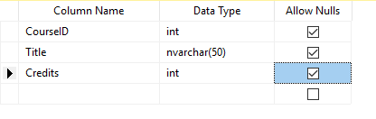
SSMS – Creating a Table
Expand the database and right-click on the Tables folder and choose Table
Type in the following fields:
Right-click on the column next to CourseID and choose Set Primary Key

Slide 5
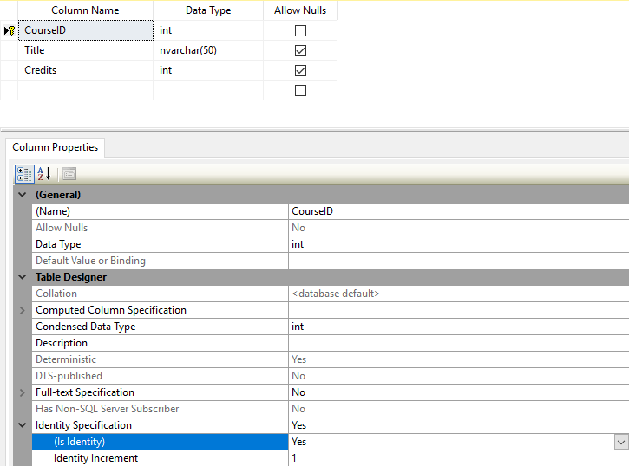
SSMS – Creating a Database
In the Column Properties window, expand Identity Specification
Change the (Is Identity) property to Yes
Right-click on the tab for the table and choose Save Table
Name your table Course

Slide 6
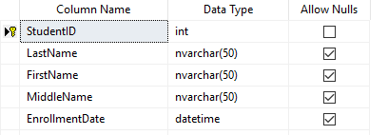
SSMS – Creating a Table
Create a Student table with the following fields:
StudentID should be an Identity field as well.

Slide 7
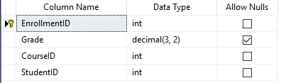
SSMS – Creating a Table
Create the Enrollment table with the following fields:
EnrollmentID is an Identity field
We will establish FKs between CourseID and StudentID

Slide 8
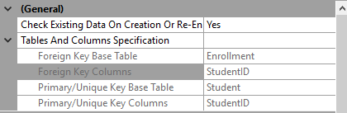
SSMS – Adding Foreign Keys
Right-click in the Table Designer and choose Relationships
Click Add
Expand Tables And Columns Specification
Fill in according to:
Repeat to establish appropriate relationship for CourseID.

Slide 9
Create project
Create an MVC project in Visual Studio as shown previously in class

Slide 10
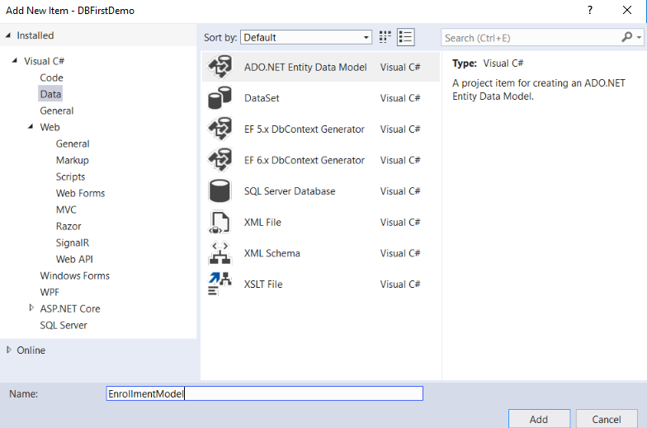
Generating the Model
Right-click the Models folder, and select Add and New Item.
In the Add New Item window, select Data in the left pane and ADO.NET Entity Data Model from the options in the center pane. Name the new model file EnrollmentModel.
Click Add.

Slide 11
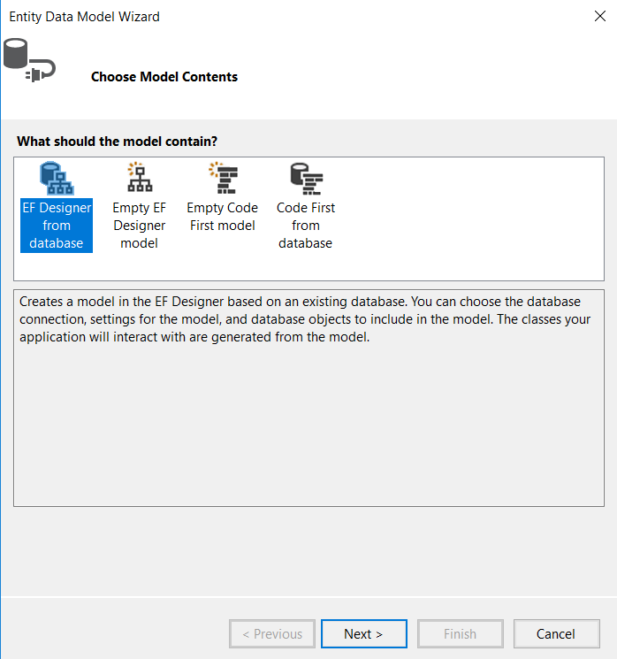
Generating Models
Select EF Designer from database
Click Next

Slide 12
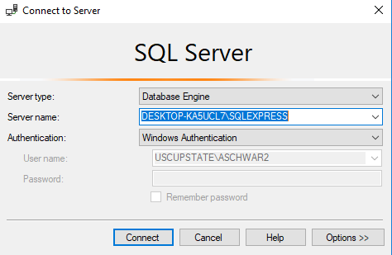
Setting up the Connection String
Click New Connection
Under Server name, enter the name of your SQL instance
Note: You can get this when you first open SSMS it’s the server name that appears there

Slide 13
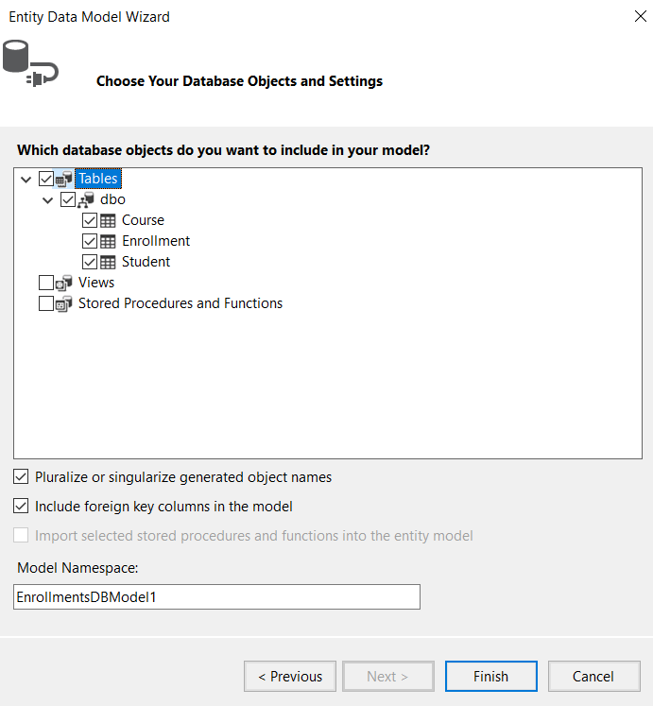
Setting up the Connection String
Enter EnrollmentDB for the name of the database and click OK.
Click Next.
Select Tables to generate models for all three tables.
Click Finish.
If you get a Security Warning, Click OK.

Slide 14
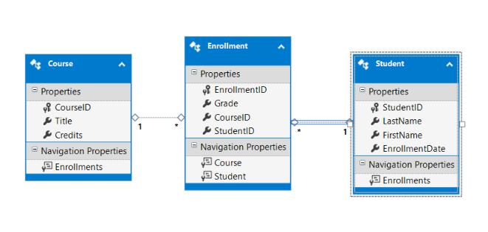
Generating Models
The models are generated from the database tables, and a diagram is displayed that shows the properties and relationships between the tables.
Build your project.

Slide 15
Scaffolding
Now we can generate code that will provide standard data operations for the model classes.
Right-click on the Controllers folder and select Add -> New Scaffolded Item
Select MVC 5 Contoller with views, using Entity Framework
Select Student for the Model Class
Select EnrollmentsDBEntities for the Data context class.
Click Add.
Repeat for Course & Enrollment
Browse to the appropriate URL’s and choose your new pages

Slide 16
Changing your Database
If you update the structure of a table in your database, you need to ensure that your change is propagated to the data model, views, and controller.
Open up the Students table in your database, and add the column MiddleName
Save the table
If you get an error about not being able to save the changes:
Go to the Tools -> Options
Click Designers
Uncheck “Prevent saving changes that require table re-creation”
Try to save again.

Slide 17
Changing your Database
The new column exists in the database, but not in the model.
Open the model
Right-click anywhere on the model page, and select Update Model from Database
Now the models have it, but unfortunately the views do not.
You can:
Re-generate the views by once again adding scaffolding for the Student class
Manually add the new property.

Slide 18
Entity Framework – Navigation Properties
Notice on your model how some of the tables have Navigation Properties
Navigation properties represent relationships for the entity.
They provide an easy way to access related entities through code instead of having to perform some additional query to manually grab them.

Slide 19
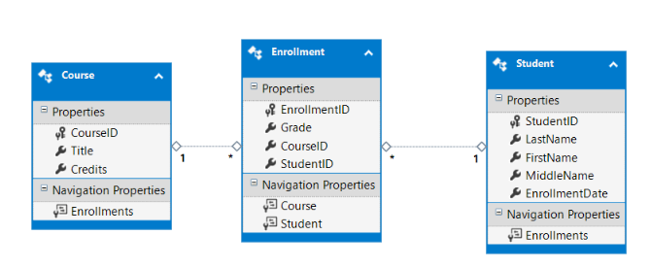
Entity Framework – Navigation Properties
For example, Student has an Enrollment Navigation property which means we can easily access the student’s enrollments from the code with no additional database querying necessary.

Slide 20
Customizing a View
Open Students/Details.cshtml, and below the last </dl> tab, but before the closing </div> tag, add the following code.
<table class="table">
<tr>
<th>
Course Title
</th>
<th>
Grade
</th>
<th>
Credits
</th>
</tr>
@foreach (var item in Model.Enrollments)
{
<tr>
<td>
@Html.DisplayFor(modelItem => item.Course.Title)
</td>
<td>
@Html.DisplayFor(modelItem => item.Grade)
</td>
<td>
@Html.DisplayFor(modelItem => item.Course.Credits)
</td>
</tr>
}
</table>

Slide 21
Querying with Entity Framework
Consider adding a page where you can select a course from a dropdown and see all students enrolled in the course.
This isn’t a type of view that is generated automatically
What data will this view need?
A list of all courses to load the dropdown
A list of students in the course selected in the dropdown.
Of course there are many different ways to accomplish this. We’ll go through one solution

Slide 22
The View
@{
ViewBag.Title = "Search";
IEnumerable<SelectListItem> courseList = ViewData["Courses"] as IEnumerable<SelectListItem>;
IEnumerable<DBFirstDemo.Models.Student> students = ViewData["Students"] as IEnumerable<DBFirstDemo.Models.Student>;
}
<h2>Search</h2>
<div>
@using (Html.BeginForm("Search", "Courses", FormMethod.Post))
{
@Html.DropDownList("ddlCourse", courseList, new { @onchange = "this.form.submit()" })
}
<table class="table">
<tr>
<th>
First Name
</th>
<th>
Last Name
</th>
</tr>
@foreach (var item in students)
{
<tr>
<td>
@Html.DisplayFor(modelItem => item.FirstName)
</td>
<td>
@Html.DisplayFor(modelItem => item.LastName)
</td>
</tr>
}
</table>
</div>

Slide 23
The Controller
[HttpGet]
public ViewResult Search()
{
int courseID = db.Courses.First().CourseID; //query from db and get the CourseID of the first entry
List<Course> courseList = db.Courses.ToList(); //get all of courses from db
//create the dropdown items and select the first course from the db
IEnumerable<SelectListItem> courseDropDown = courseList.Select(c => new SelectListItem()
{
Text = c.Title,
Value = c.CourseID.ToString(),
Selected = (c.CourseID == courseID)
});
//save in ViewData to be accessed from View
ViewData["Courses"] = courseDropDown;
//Get list of students in the course selected
var studentsInCourse = from s in db.Enrollments.Include("Students")
where s.CourseID.Equals(courseID)
select s.Student;
//save in ViewData to be accessed from View
ViewData["Students"] = studentsInCourse;
return View();
}

Slide 24
The Controller
[HttpPost]
public ActionResult Search(int? dummy)
{
ViewData["selectedCourse"] = Request["ddlCourse"]; //get the selected item from dropdown
int courseID = Int32.Parse(ViewData["selectedCourse"].ToString()); //save it in a variable to use in querying
//get all courses from the db for the dropdown, and select the one that was previously selected
List<Course> courseList = db.Courses.ToList();
IEnumerable<SelectListItem> courseDropDown = courseList.Select(c => new SelectListItem()
{
Text = c.Title,
Value = c.CourseID.ToString(),
Selected = (c.CourseID == courseID)
});
//save in ViewData so the view can display in dropdown
ViewData["Courses"] = courseDropDown;
//query database for any students in the selected course
var studentsInCourse = from s in db.Enrollments.Include("Students") //the include in EF is similar to a join
where s.CourseID.Equals(courseID)
select s.Student;
//save in ViewData so the view can display in dropdown
ViewData["Students"] = studentsInCourse;
return View();
}
}

